Slide 1
Simulation report
Assignment #2
444105788@student.ksu.edu.sa

Slide 2
Tasks at hand
Do the following in order :
1- Read The book chapter I of the book (Simulation modeling and analysis/ by Averill M. Law, W.)
2- Go to author site to down load the simulation program of the M/M/1 queue
3- Run the program for the following input : with 20000 customers Then Evaluate the results for the following performance measures
4- Use the attach ached handout to evaluate these measures analytically using queuing formula
5- Tabulate & Plot the results for the measures both analytic and from simulation as a function of Utilization
6- Prepare a report with the above

Slide 3
Task #1: Read chapter 1 from the book
Basics of simulation
Types of simulation
Single-server queuing system: M/M/1 and M/D/1 queues
A sample C program

Slide 4
Task #2 : Get the program from author website
The example simulation program was provided in various languages. We chose C language.
Include ”lcgrand.h”: create/ copy header file in the directory.

Slide 5
Task #3 : Run the simulation program(1)
For the following input, run the M/M/1 simulation for 20000 customers.
Mean interarrival time ( minutes) 1.000 1.000 1.000 1.000 1.000 Mean service time minutes 0.300 0.400 0.500 0.600 0.700

Slide 6
Task # 3: Run the program(2)
Then Evaluate the results for the following performance measures :
- mean time an item spends in system
- mean number of items waiting to be served
- mean waiting time (including items that have to wait and items with waiting time = 0)
- Average delay in queue
- Average number in queue

Slide 7
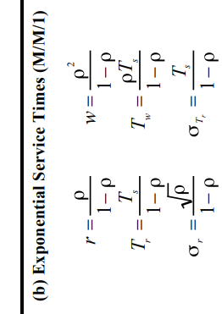
Task #4 : Analytical evaluations using queue formulae
Formulae available in queue.pdf
Use M/M/1

Slide 8
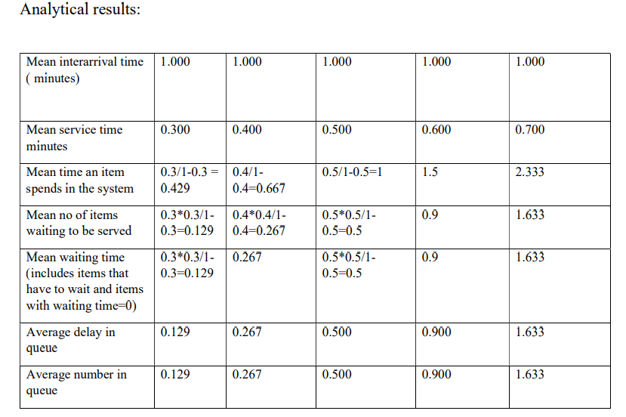
Task #5 Tabulate and plot the results(1)

Slide 9
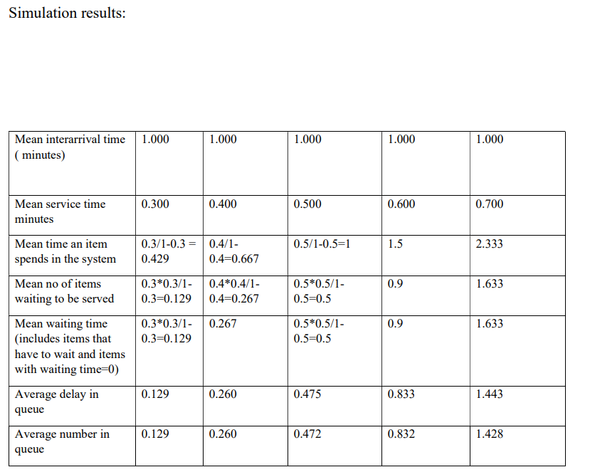
Task #5 (2)

Slide 10
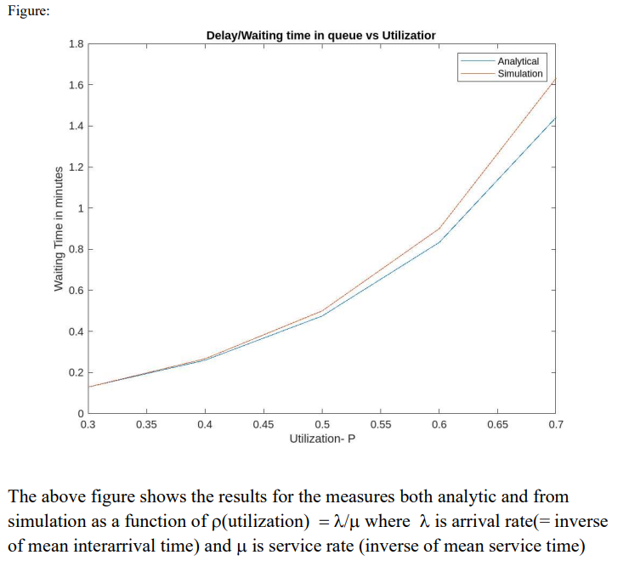
Task #5(3)
Plot using MATLAB:
x = [0.3,0.4,0.5,0.6,0.7];
y1 = [0.129,0.260,0.475,0.833,1.443];
y2 = [0.129,0.267,0.5,0.9,1.633];
plot(x,y1,x,y2) legend({'Analytical','Simulation'},'Location','northeast’)
title('Delay/Waiting time in queue vs Utilization’)
xlabel('Utilization- P’)
ylabel('Waiting Time in minutes')

Slide 11
Task #6 : Prepare report and submit
Finish

Slide 12
Thank You

